Slide 1
Nonlinearity

Slide 2
Dataset
California Test Score Dataset:
All K-6 and K-8 California school districts (n = 420)
Variables:
5th grade test scores (Stanford-9 achievement test, combined math and reading), district average
Student-teacher ratio (STR) = no. of students in the district divided by no. full-time equivalent teachers
Income_{i} = average district income in the i^{th} district (thousands of dollars per capita)

Slide 3
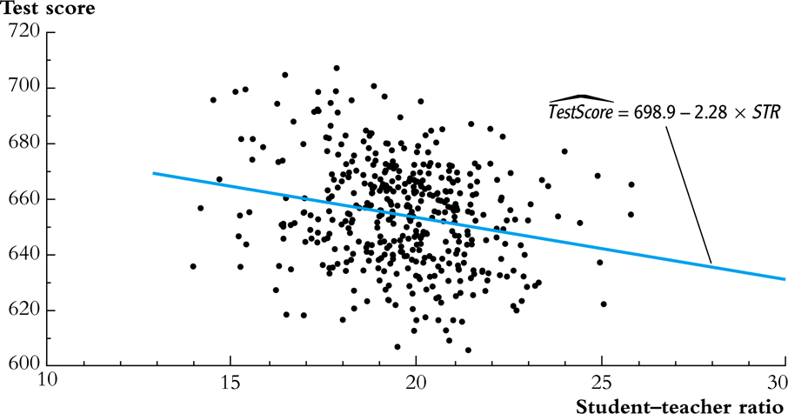
The TestScore – STR relation

Slide 4
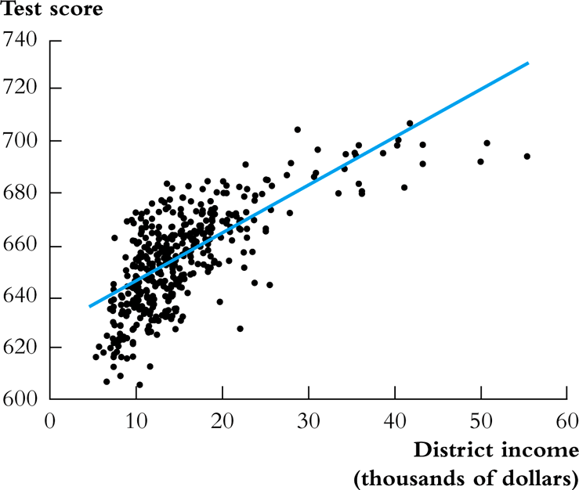
The TestScore – Income

Slide 5
Nonlinear Regression Functions
If a relation between Y and X is nonlinear:
The solution is to estimate a regression function that is nonlinear in X
The marginal effect of X is not constant
The effect on Y of a change in X depends on the value of X
WHY?

Slide 6
Conversion of Nonlinear to Linear

Slide 7
Conversion of Nonlinear to Linear
Polynomials in X
The regression function is approximated by a quadratic, cubic, or higher-degree polynomial
Logarithmic transformations
Y and/or X is transformed by taking its logarithm

Slide 8
Polynomials in X
Approximate the regression function by a polynomial:
Y_{i} = β₀ + β₁X_{i} + β₂ + … + u_{i}
This is just the linear multiple regression model – except that the regressors are powers of X
Estimation, hypothesis testing, etc. proceeds as in the multiple regression model using OLS
The coefficients are difficult to interpret, but the regression function itself is interpretable

Slide 9
Polynomials in X
Quadratic specification:
TestScore_{i} = β₀ + β₁Income_{i} + β₂(Income_{i})² + u_{i}
Cubic specification:
TestScore_{i} = β₀ + β₁Income_{i} + β₂(Income_{i})² + β₃(Income_{i})³ + u_{i}

Slide 10
Estimation Results (quadratic specification)
Regression with robust standard errors Number of obs = 420
F( 2, 417) = 428.52
Prob > F = 0.0000
R-squared = 0.5562
Root MSE = 12.724
------------------------------------------------------------------------------
test score | Coef. Std. Err. t P>|t| [95% Conf. Interval]
-------------+----------------------------------------------------------------
avginc | 3.850995 .2680941 14.36 0.000 3.32401 4.377979
avginc2 | -.0423085 .0047803 -8.85 0.000 -.051705 -.0329119
_cons | 607.3017 2.901754 209.29 0.000 601.5978 613.0056
------------------------------------------------------------------------------
Test the null hypothesis of linearity against the alternative that the regression function is a quadratic.

Slide 11
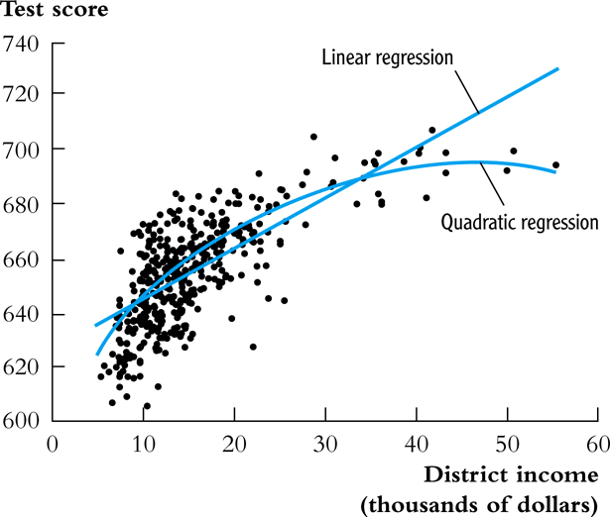
Estimation Results (quadratic specification)
Plot the predicted values
Test Score = 607.3 + 3.85Income_{i} – 0.0423(Income_{i})²
(2.9) (0.27) (0.0048)

Slide 12
Estimation Results (quadratic specification)
Compute “effects” for different values of X
Test Score = 607.3 + 3.85Income_{i} – 0.0423(Income_{i})²
Predicted change in TestScore for a change in income from $5,000 per capita to $6,000 per capita:
Δ Test Score = 607.3 + 3.85×6 – 0.0423×6²
– (607.3 + 3.85×5 – 0.0423×5²) = 3.4
Predicted “effects” for different values of X:
The “effect” of a change in income is greater at low than at high income levels (perhaps, a declining marginal benefit of an increase in school budgets?)
Change in Income ($1000 per capita) | ΔTest Score
from 5 to 6 | 3.4
from 25 to 26 | 1.7
from 45 to 46 | 0.0

Slide 13
Estimation Results (cubic specification)
Regression with robust standard errors Number of obs = 420
F( 3, 416) = 270.18
Prob > F = 0.0000
R-squared = 0.5584
Root MSE = 12.707
------------------------------------------------------------------------------
testscr | Coef. Std. Err. t P>|t| [95% Conf. Interval]
-------------+----------------------------------------------------------------
avginc | 5.018677 .7073505 7.10 0.000 3.628251 6.409104
avginc2 | -.0958052 .0289537 -3.31 0.001 -.1527191 -.0388913
avginc3 | .0006855 .0003471 1.98 0.049 3.27e-06 .0013677
_cons | 600.079 5.102062 117.61 0.000 590.0499 610.108
------------------------------------------------------------------------------

Slide 14
Estimation Results (cubic specification)
Testing the null hypothesis of linearity, against the alternative that the population regression is quadratic and/or cubic, that is, it is a polynomial of degree up to 3:
H₀: population coefficients on Income² and Income³ = 0
H₁: At least one of these coefficients is nonzero.
The hypothesis that the population regression is linear is rejected at the 1% significance level against the alternative that it is a polynomial of degree up to 3.

Slide 15
Logarithmic transformations

Slide 16
Logarithmic functions of Y and/or X
Case | Population regression function
I. linear-log | Y_{i} = β₀ + β₁ln(X_{i}) + u_{i}
II. log-linear | ln(Y_{i}) = β₀ + β₁X_{i} + u_{i}
III. log-log | ln(Y_{i}) = β₀ + β₁ln(X_{i}) + u_{i}
The interpretation is found by applying the general “before and after” rule: “figure out the change in Y for a given change in X.

Slide 17
I. Linear-log regression function
Compute Y “before” and “after” changing X:
Y = β₀ + β₁ln(X) (“before”)
Y + ΔY = β₀ + β₁ln(X + ΔX) (“after”)
Subtract (“after”) – (“before”): ΔY = β₁[ln(X + ΔX) – ln(X)]
ln(X + ΔX) – ln(X) = ≅
ΔY ≅ β₁ = 0.01β₁ * % change of X
1% increase in X => 0.01 increase in ln(X) => 0.01β₁ increase in Y

Slide 18
Estimation Results (Test Score vs. ln(Income))
The model is now linear in ln(Income), so the linear-log model can be estimated by OLS:
Test Score = 557.8 + 36.42×ln(Income_{i})
(3.8) (1.40)
so a 1% increase in Income is associated with an increase in TestScore of 0.36 points on the test
All the usual tools of regression (R², Standard errors, and confidence intervals apply here)

Slide 19
II. Log-linear regression function
ln(Y) = β₀ + β₁X (b)
Now change X: ln(Y + ΔY) = β₀ + β₁(X + ΔX) (a)
Subtract (a) – (b): ln(Y + ΔY) – ln(Y) = β₁ΔX
so ≅ β₁ΔX
1 unit increase in X => β₁ increase in ln(Y) => 100β₁% increase in Y

Slide 20
III. Log-log regression function
ln(Y_{i}) = β₀ + β₁ln(X_{i}) + u_{i} (b)
Now change X: ln(Y + ΔY) = β₀ + β₁ln(X + ΔX) (a)
Subtract: ln(Y + ΔY) – ln(Y) = β₁[ln(X + βX) – ln(X)]
so ≅ β₁
or β₁ ≅ (small ΔX)
1% change in X is associated with a β₁% change in Y
In the log-log specification, β₁ has the interpretation of an elasticity

Slide 21
Estimation Results (ln(TestScore) vs. ln(Income))
The model is now a linear regression of ln(TestScore) against ln(Income), which can be estimated by OLS:
In(Test Score) = 6.336 + 0.0554×ln(Income_{i})
(0.006) (0.0021)
An 1% increase in Income is associated with an increase of .0554% in TestScore (Income up by a factor of 1.01, TestScore up by a factor of 1.000554)
For example, suppose income increases from $10,000 to $11,000, or by 10%. Then TestScore increases by approximately .0554×10% = .554%. If TestScore = 650, this corresponds to an increase of .00554×650 = 3.6 points

Slide 22
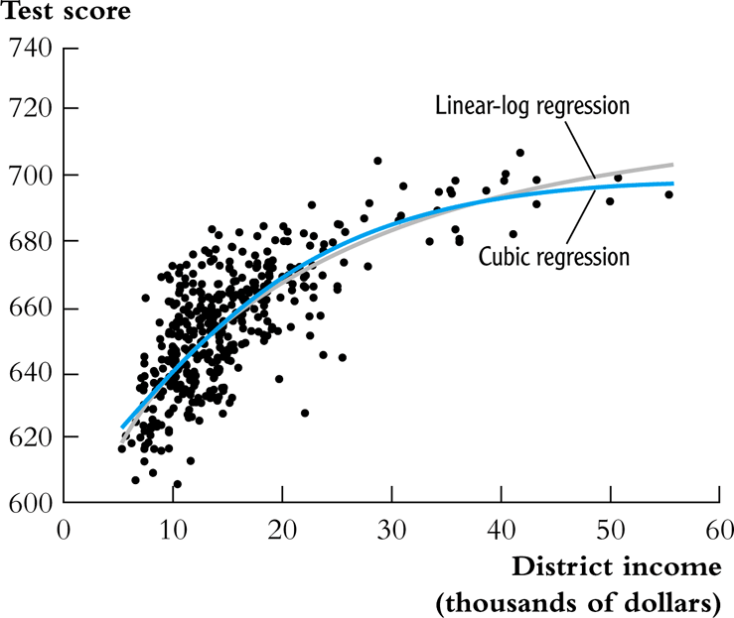
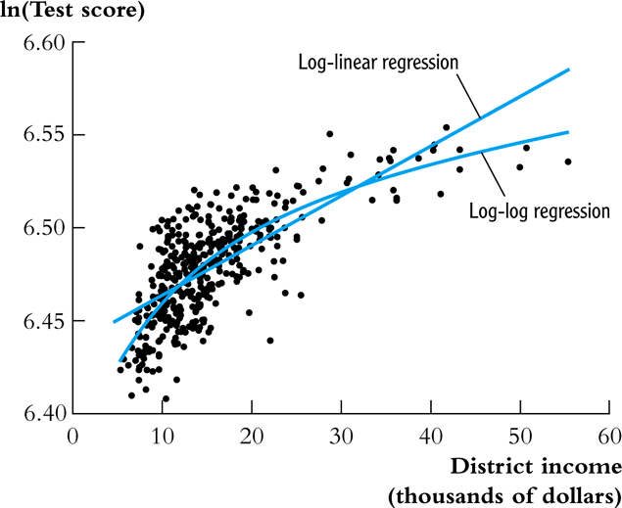
Plot the predicted values

Slide 23
Nonlinear Regression Model

Slide 24
“REAL” nonlinear function
The foregoing regression functions have limitations
Polynomial: test score can decrease with income
Linear-log: test score increases with income, but without bound
Here is a nonlinear function in which Y always increases with X and there is a maximum (asymptote) value of Y:
Y =
where β₀, β₁, and α are unknown parameters
This is a negative exponential growth curve. The asymptote as X → ∞ is β₀

Slide 25

Negative exponential growth
We want to estimate the parameters of,
Y_{i} =
or
(*)
where α =
Compare model (*) to linear-log or cubic models:
Y_{i} = β₀ + β₁ln(X_{i}) + u_{i}
Y_{i} = β₀ + β₁X_{i} + β₂ + β₂ + u_{i}
The linear-log and polynomial models are linear in the parameters β₀ and β₁ – but the model (*) is not
$$Y_{i}=β_{0}\left[1−e^{−β_{1}X_{1}+β_{2}}\right]$$

Slide 26
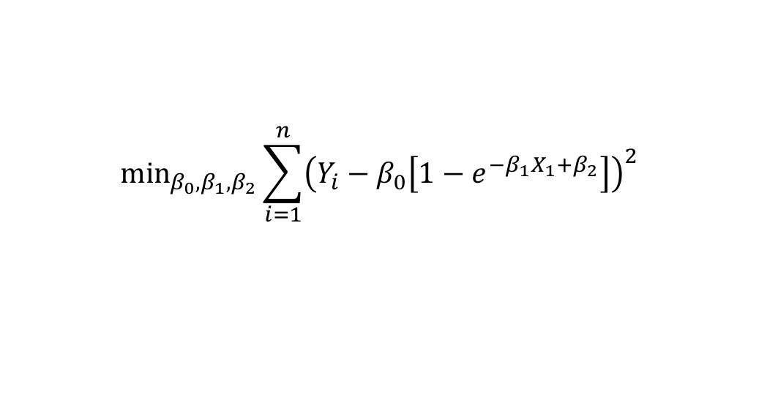
Nonlinear Least Squares
Models that are nonlinear in parameters can be estimated by nonlinear least squares (NLS)
The NLS problem for the proposed specification:
This is a nonlinear minimization problem
$$\min_{β_{0},β_{1},β_{2}}\sum_{i=1}^{n}{{\left(Y_{i}−β_{0}\left[1−e^{−β_{1}X_{1}+β_{2}}\right]\right)}^{2}}$$

Slide 27
Nonlinear Least Squares
. nl (testscr = {b0=720}*(1 - exp(-1*{b1}*(avginc-{b2})))), r
(obs = 420)
Iteration 0: residual SS = 1.80e+08 .
Iteration 1: residual SS = 3.84e+07 .
Iteration 2: residual SS = 4637400 .
Iteration 3: residual SS = 300290.9 STATA is “climbing the hill”
Iteration 4: residual SS = 70672.13 (actually, minimizing the SSR)
Iteration 5: residual SS = 66990.31 .
Iteration 6: residual SS = 66988.4 .
Iteration 7: residual SS = 66988.4 .
Iteration 8: residual SS = 66988.4
Nonlinear regression with robust standard errors Number of obs = 420
F( 3, 417) = 687015.55
Prob > F = 0.0000
R-squared = 0.9996
Root MSE = 12.67453
Res. dev. = 3322.157
------------------------------------------------------------------------------
| Robust
testscr | Coef. Std. Err. t P>|t| [95% Conf. Interval]
-------------+----------------------------------------------------------------
b0 | 703.2222 4.438003 158.45 0.000 694.4986 711.9459
b1 | .0552339 .0068214 8.10 0.000 .0418253 .0686425
b2 | -34.00364 4.47778 -7.59 0.000 -42.80547 -25.2018
------------------------------------------------------------------------------
(SEs, P values, CIs, and correlations are asymptotic approximations)

Slide 28
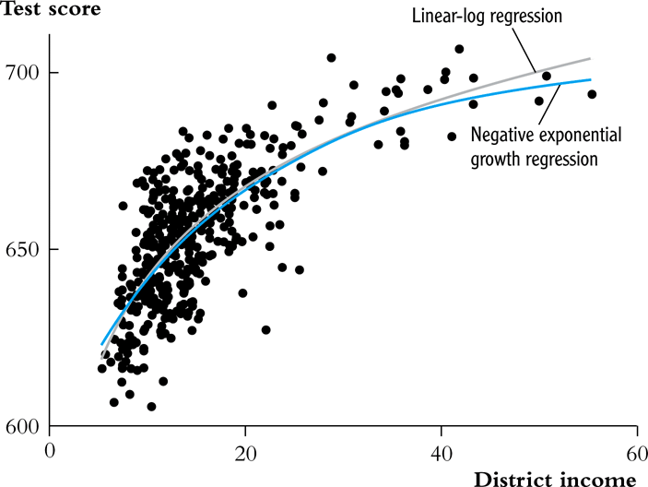
Plot the predicted values

